Slide 1
Philip Allan Updates Online Seminar
Preparing for Edexcel GCE Geography Unit 4 Researching Geography
December 2014

Slide 2
Your course tutor
David Holmes

Slide 3
Programme for today’s session
3.30 pm Welcome and sound checks
3.35 pm The Unit 4 product – what examiners expect and problem areas
3.45 pm Unpacking the generic mark scheme sections
4:10 pm Brief break
4.15 pm Interpreting the pre-release research focus and preparing during the pre-release phase
4:30 pm Reviewing some examples
4:50 pm Chance to ask questions
5.00 pm Finish
Some polls to get to know you all!

Slide 4
Unit 4: Geographical Research
General points:
Tectonics still most popular (Jun14 graph).
Grade boundaries have risen over time – more so at E – but marks fairly stable
Mean marks varies from 52 for Q3 to 47 for Q6.
Timing problems rarely an issue.
Most work is now in the form of a report, not an essay.
 | Unit 4 Award
 | June 2011 | Jan 2012 | June 2012 | Jan 2013 | June 2013 | June 2014
A | 52/70 | 55/70 | 54/70 | 54/70 | 57/70 | 56/70
E | 34/70 | 36/70 | 35/70 | 37/70 | 38/70 | 38/70

Slide 5
Think about the sort of marks needed:
Mark scheme area | A* (aim for about 62) | A | C | E
D | 9 | 9 | 7 | 6
R | 13 | 12 | 10 | 8
A | 18 | 16 | 13 | 10
C | 13 | 11 | 10 | 8
Q | 9 | 8 | 7 | 6
Total | 62 | 56 | 47 | 38
Candidates can’t afford a slip up in one area.
Failure to get around to a decent conclusion might mean getting a mark of 6 / 15 rather than 11 / 15 – in which case they will be in danger of losing a whole grade.
That said, most reports are now ‘full’ i.e. a decent attempt is made at all sections.

Slide 6
Unit 4: Overall comments Jun14
The Question in the exam is usually a contentious statement; it has a ‘twist’ in relation to the pre-release information.
The introduction should make clear what the general argument is – to help stay on track throughout.
Students must not write all they know about a particular subject/issue but address question posed.
Success comes through the candidates' ability to interpret the question - hence the importance of the planning page
The expected product is a report although the analysis and conclusion should be analytical in the manner of an essay.

Slide 7
Majority include ongoing evaluation – important because it prevents wandering away form the focus of the question
Candidates need to use words in the question in their answer.
Also need to 'come to a view‘ about the question and try and avoid sitting on the fence.
Keep a close eye on the time – the analysis and conclusion are the most important parts of the report.
Relevance of case study evidence is paramount. What exactly is the evidence of?
Ensure that all key terms are addressed and defined– remember that the correct definitions of some terms are hotly disputed.
Provide sources throughout.

Slide 8
June 14 questions: some key points
1 Assess the reasons why the management of some tectonic hazards is more successful than others. | Essentially a comparative question, in terms of hazard type and management approach; basically what works best? What doesn’t, and why? What are criteria going to be to judge ‘success’?
2 The differences between glacial landscapes are best explained by variations in the physical processes that formed them. Discuss. | Key focus is landscapes, not landforms. The question can’t really be answered without referring to at least two different landscapes. ‘Are best’ leaves the door open to other factors, such as climatic factors rather than geomorph processes only.
3 Strategies for increasing global food supply are inevitably unsustainable. Discuss. | The global focus is easy to miss – some global context needed. Criteria are needed to judge sustainability (or not), plus the inevitable part needs to be addressed – a lot of balls in the air here.
4 To what extent is it true that the least culturally diverse places are the most geographically isolated? | A ‘how far’ question, so the answer lies somewhere on a spectrum from ‘totally’ to ‘not at all. Case study / example choice important because high / low diversity and isolated / connected needs to be covered.
5 To what extent is the level of health risk best explained by socio-economic status? | ‘Best’ is perhaps the key here, as it opens the door to a range of other factors beyond socio-economic status. A ‘how far’ question, so the answer lies somewhere on a spectrum from ‘totally’ to ‘not at all.
6 Some rural landscapes are vulnerable to the impacts of leisure and tourism than others. Discuss. | Another question where criteria to judge vulnerability is important; there is a danger than answers focus on the impacts, not the vulnerability of the landscape.

Slide 9
Some problematic report types
Type | Problems | Over to you….
The world tour | List of case-studies from around the world Very descriptive, but often factually dubious Tenuous link to the question No argument. | Lots of work on command word meaning especially assess, discuss etc Focus on the analysis section (being comparative, ongoing evaluation)
The head –scratcher | Lacks logic Some good material, but changes direction too often Clearly has an argument but can’t quite convey this | Need to gain the confidence to stick to a position / argument and defend it Think evidence for / evidence against
The ‘wing-it’ | Logical argument but not backed up by evidence, research etc | The good ones that won’t revise, you just have to make them Focus on key words in MS like evidence etc
The exception | An argument, but its just not convincing Often puts too much store in the ‘exception that disproves the rule’ Focussed on the unimportant | Needs a ‘real world’ injection May need additional material / research to see that the exceptions are just that, exceptions

Slide 10
Most common problems reasons for an unexpectedly low mark?
Not thinking about the question - spotting opportunities for discussion /debate
Not answering the question; answering a different one e.g. mock question.
Very brief, unconvincing introduction = lack of direction
Lots of descriptive case studies, poor selection and application (these candidates probably think they have done very well i.e. volume and detail).
Running out of time i.e. no time to write a conclusion
Paradox: weak candidates doing much better than expected?
Most commonly this is because they answer the question; having not really researched / revised, what else can they do?
They also don’t face the problem of having to select from huge volumes of material!

Slide 11
Problem 1: lack of planning
Thinking time needed
Relate preparation work to the actual title on the day
Avoid thinking that most of the 1 ½ hrs should be spent on the ‘main bit’ i.e. analysis
Plan a structure for the whole report
Plan the introduction and conclusion
Together these account for 25 of the 70 marks (35%)

Slide 12
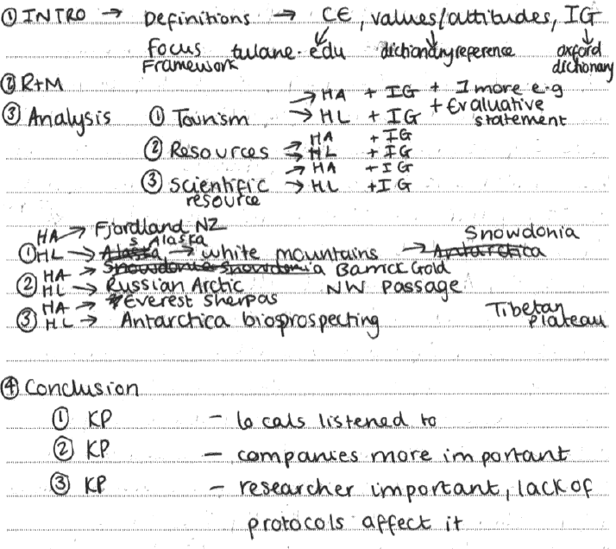
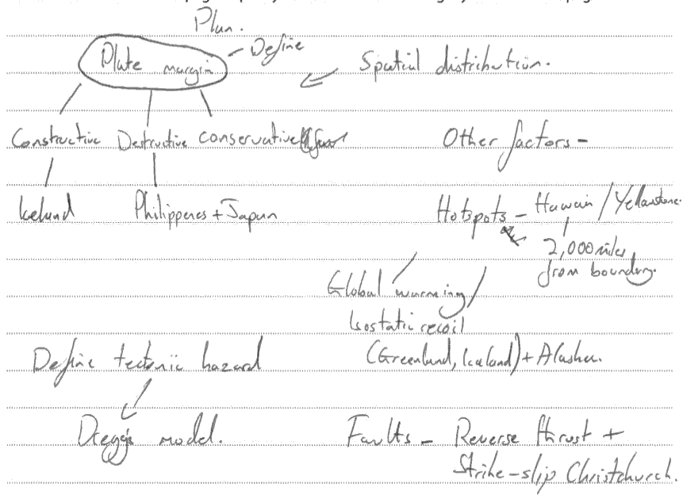
Example plans:
No ‘standard’ ‘right’ way to plan, as these examples show.
Examiners do look at plans.
They may yield marks, if a section has been planned but not attempted.

Slide 13
Problem 2: lack of selection
Students must filter what they know, to select and apply only what is relevant:
Filtering 1
During the pre-release phase, some material needs to be set aside.
The pre-release indicates what is most relevant and what is less (or not) relevant.
Filtering 2
During planning in the exam, some examples case studies, models need to be ‘ditched’ in favour of those that are most relevant to the question.
Filtering 3
Lastly, students need to filter out the parts of case studies that are most relevant
Examiners do not want to know everything....!

Slide 14
Problem 3: mark scheme ‘hurdles’
No introduction and / or conclusion severely limits marks, but be aware that:
Ongoing evaluation + conclusions are required (not just a final conclusion)
No indication on methodology at all limits the mark to maximum 11/15 for Researching & Methodology
Essay style answers, with no report sub-sections, are likely to score 5-6 maximum in QWC.
QWC mark further lowered by no sourcing and referencing.

Slide 15
Problem 4: diagrams and models
Good idea, generally
2 or 3 per report (but sometimes none are relevant, which is OK)
Best tend to be conceptual i.e. models, flow diagrams, spectrum diagrams
Beware drawing 3 or 4 models (Health & Rural options suffer from this) – this makes a Report very complex
Weakest tend to be the ‘prettiest’:
3D block diagrams of plate margins
World map distributions (HDI in all countries)
Drawn ‘photos’ (no joke!)
Landform formation sequences ‘The 8 stages of pingo formation’
Very time consuming art work usually adds very little....

Slide 16
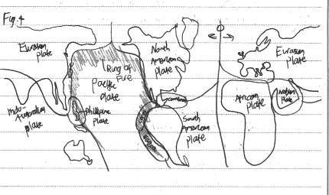
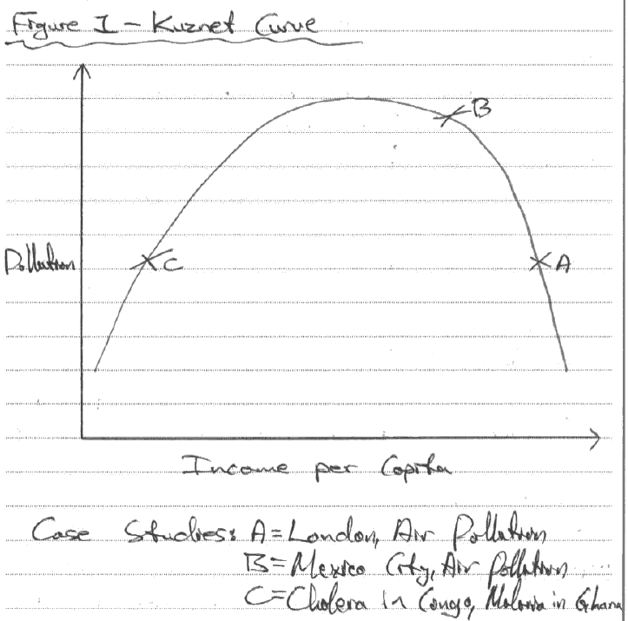
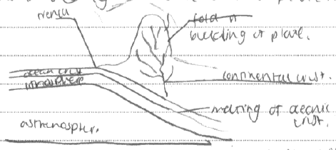
Which is which?
Simple, applied to the report
In a 90 minute exam?
Can you see what it is yet?

Slide 17
Unpacking the generic mark scheme
Generic mark scheme applies to all Unit 4 options
Crucial to understand all parts, and mark weighting
Make students aware of the ‘hurdles’ discussed earlier
Try and mark and practice reports / mocks using it
Very different to the way extended writing is marked in Units 1-3

Slide 18
Introduction: shop window of the Report
9-10 | Clear reference to title: develops a focus Indication of framework, either by concepts and/or case studies Accurate definitions of key terms
Focus (direction, argument)
Framework (structure, parameters, scope)
Definitions (from the Report title)
Many reports have incomplete coverage of these aspects
Better ones reference definitions; include quotes
A model / theory provides a framework – as long as it is referred to again in the analysis / conclusion.
Justifying particular examples / case studies helps the Report flow more successfully
Avoid sub-sub-sections e.g.
1.1.1. Definitions
The words I need to define are......
1.1.2 Focus
The focus of this report is .....(rewrites question)
This style tends to lead to a very broken up / ‘bitty’ intro.

Slide 19
Introductions
Q1:The number of tectonic hazards is not increasing but their impact has become more disastrous. Discuss
3 Paras
1 ½ sides
Define tectonic hazard + disaster (crucial difference) – state some ‘killer’ facts (death tolls, trends). Consider what impacts might mean (soc/ eco/ pol etc)
Possibly a quote e.g. UNISDR
Need to decide on a timescale (s), so what’s it going to be?
Focus on some criteria to make a judgment i.e. decide how to measure impacts
Concepts / models introduced (and drawn?)
Where is the report going? What’s the thrust of the argument going to be?
Structure of the evidence to be presented?
Case studies and examples – why chosen?
Definitions
Focus
Framework

Slide 20
Example: last paragraph of an introduction:
In order to assess whether the number of tectonic events is not increasing but their impact is becoming more disastrous this report will first analyse the data on tectonic events and disasters over the last 30 years using databases such as EM-Dat. Secondly several different examples of events will be examined such as comparing the impacts of the 1993 and 2011 Japanese tsunamis. The trend in volcanic disasters will also be examined with reference to events such as Mt Pinatubo and Nevada del Ruiz in 1985. Lastly earthquakes in the developing world will be examined. It is important to consider the developed and developing world in order to be able to assess whether vulnerability in increasing and this one reason the examples have been chosen. The report will show that there is little evidence for more tectonic hazards but there is some evidence that major earthquake disasters are becoming more common and larger in the developing world but that volcanic disasters are being reduced worldwide.
Uses words from title
Expect sections on trends, comparisons
Example / CS choice indicated and explained
Indication of where the report is headed
(argument)

Slide 21
Researching & Methodology
12-15 | Wide range of relevant case studies used (by scale and or location). Relevant concepts, and/or theories used Factual, topical evidence Indication of methodology i.e. how evidence was sampled/selected
Indicate how, and why, various sources were used
Format could be:
A paragraph on methods and research sources
A methodology table
Integrated with referencing, like this:
“The 2008 Sichuan earthquake in China was a devastating event. Details of it causes and impacts were researched in Geography Review (D Petley, 2009) which is a well respected, unbiased source. Prof Petley is director of the Landslides Research Centre at Durham Uni.”

Slide 22
Some comments need to be made on sources, but:
Not slavishly for every source used
Not all types of comments for all sources
Possible comments include:
Selection | Brief explanations of why particular material was used e.g. one website over another
Range of research | Commenting on the range of research sources uses i.e. to provide balance and avoid bias
‘Age’ of resources | Commenting on how up to date some materials are, compared to others
Bias | Commenting on the bias that might be present in some sources e.g. the Economist compared to New Internationalist
Reliability | Commenting on the authors e.g. academic researchers versus opinions in blogs or newspaper articles
Comparison | Comparing one source to another and identifying discrepancies e.g. earthquake death tolls of economic losses

Slide 23
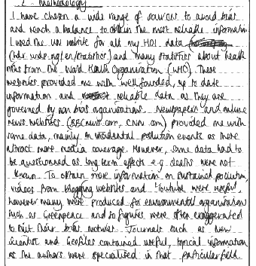
…..a methodology paragraph?
This is the most common approach
Keep it brief-ish
Maybe ½ to ¾ side max
Tables are fine, if kept simple
3 columns, not 5 or 6!
Source + how it will be used + comments on the source
Tables need to avoid needless repetition (group sources by type)

Slide 24
Huge methodology is not required because there are also marks in this section for:
A wide range of case studies
Relevant concepts and theories
Factual, topical evidence
Some candidates need a steer on their overall choice of evidence:
Good choice ☺ | Poor choice ☹
Kashmir earthquake, 2005 Samoa tsunami, 2009 Mount Pinatubo, 1991 Kobe earthquake , 1995 Haiti earthquake, 2010 | Kashmir earthquake, 2005 Bam earthquake, 2003 Sichuan earthquake, 2008 Tangshan earthquake, 1976 Great Kanto earthquake, 1923

Slide 25
Analysis and Application
Large % of the overall marks.
Can be over-long, and all rather descriptive / ‘my next case study is’….
A mix of detailed case studies (3 or 4) and small, less detailed examples that either support the main case study (bolstering the argument), and contrast with it (making more complex points) works well.
An example could be an argument that volcanic risk has been reduced by prediction (Mt Pinatubo CS supported by Mt Merapi example), but not in all cases (Mt Ontake example – see later today).
This is much more valuable than 1 ½ sides on every aspect of Mt Pinatubo.!
17-20 | All research applied directly to question set High conceptual understanding Cogent argument Appreciation of different values/perspectives about the question Any maps/diagrams are used to support answer | MS

Slide 26
Analysis and Application
Good | Less good
Selects & applies | Descriptive ‘everything I know’
CS / examples illustrate different points | ‘Different’ case studies actually the same.
Factually accurate | Inaccurate
Clear explanations; complex ideas | Simplistic, lacks understanding
Clear, logical argument | No argument, just ‘stuff’
Balanced view | Unbalanced; stereotypical
Linked; one example / idea leads to another | Separate accounts, usually ‘the next case study is’
Ongoing evaluation helps link sections | No ongoing evaluation
Diagrams chosen carefully & used | Pictures make it look pretty

Slide 27
Probably best with 3 or 4 conceptual sections.
Many candidates number these.
Any more, and the Report becomes overloaded and a conclusion becomes rather elusive.
Steer clear of ‘case study’ sections if possible.
The case study approach works against comparison and evaluation i.e. high level thinking skills.
Rather than naming the case study in section headings, identify the theme:
Q3 June 14 Strategies for increasing global food supply are inevitably unsustainable. Discuss.
CASE STUDY | CONCEPTUAL
1. Green Revolution in India | Hi-tech approaches: GM and GR compared.
2. Intermediate technology in Bangladesh | Is intermediate technology sustainable? contrasting examples.
3. UK organic farming | Food supply in urban areas
4. Food aid in Ethiopia | Does aid have a role in securing food supply?

Slide 28
Ongoing evaluation & conclusions
12-15 | Clearly stated Thorough recall of content/case studies used in essay Ongoing evaluation throughout report Understands the complexity of the question
Good test: can identify title question from conclusion alone?
What is needed?
Recall / summary of main content – what does is show / prove?
Group examples/ CS rather than list them.
3 or 4 general concluding statements need to be teased out, linked back to the Report title
Identify possible anomalies
Refer back to any models / theory - essential
Identify complexity in the question i.e. there is no single ‘answer’ , or more than one viewpoint.
Last few lines need to answer the Report title directly, using words from it

Slide 29
Ongoing evaluation also needed:
This can be done in a number of ways, within the analysis section. Using ‘Summary’ or ‘Ongoing evaluation’ sub-section headings is fine:
Summary “The green revolution has on balance proved successful in India, increasing food production by over 90% and this out-weighs the social polarisation impacts and questionable environmental impacts.” | Summary + link “The two examples show that Aids/HIV can be managed reasonably successfully in both the developed and developing world, however as the case studies of obesity will show this is not the case for all health issues.”
Spectrum “Returning to the model from the introduction, the sustainability of the examples in the developing world can be seen as:” | Table format
Benefits | Costs
Self sufficiency Boost to economic growth Food security enhanced | Monocultures Social polarisation Eutrophication

Slide 30
QWC
Easy to start sliding downwards here i.e.
Essay not a report ✗
Dodgy vocab ✗
Endless, ill-used diagrams ✗
Forgetting to reference / state sources ✗
Only referring to websites (fairly common!) ✗
9-10 | Coherent structure and sequencing with obvious report style sub sections Excellent standards of spelling and punctuation Geographical vocabulary used correctly Diagrams/maps, if used, incorporated into text and support argument Referenced/acknowledged material :obvious evidencing / sourcing from wide range of sources (texts, journals, internet, DVDs etc)

Slide 31
The pre-release & question
The ‘explore’ bullet gives you an idea of which concepts, ideas and theories you need to focus on.
The ‘research’ bullet makes suggestions about the range of case studies and examples you need.
Within the pre-release statement will be key words.
These words can also be found of you look in the specification
the pre-release statement is identifying the areas of the specification which the examination question will focus on; for instance:

Slide 32
Pre-release research focus ⬇
Specification ⬇ | Section 2 Section 3
Exam Question

Slide 33
Pre-release dangers:
Over –analysing it; getting ‘hung up’ on the meaning of one word.
Focusing on one aspect at the expense of others.
Negative interpretations e.g. impacts, challenges, effects, consequences.
Pre-judging the question
Actual question: Evaluate the importance of developing sustainable strategies to manage food security.
Easy to assume ‘food security’ is understood + can get ignored at expense of the strategies.
Need and effectiveness – latter a strong hint at evaluation.
Explore the need for, and effectiveness of, different strategies that are designed to improve food security.
Research a range of food security strategies, including ‘sustainable ones’, at differing scales and locations
‘Including’ implies + others; important when you look at the Q
Important to avoid a narrow answer

Slide 34
Understanding question complexity:
The complex, actual question:
Q1: The number of tectonic hazards is not increasing but their impact has become more disastrous. Discuss
The simpler question many answered:
Explain how the impacts of tectonic disasters are increasing over time.
Problem? Ignores the hazard / disaster trends debate. Becomes more one-sided and narrative i.e. lots of examples of ever-worse disasters. Conclusion becomes more basic as there is no debate.
The complex, actual question:
Q3: Evaluate the importance of developing sustainable strategies to manage food security.
The simpler question many answered:
Explain how sustainable strategies can increase food security.
Problem? Evaluation has disappeared. No debate about importance, or the role of other strategies. Tends to become a list of sustainable strategies.

Slide 35
Developing criteria and making judgments
Some of the key words in the question require criteria to be set out.
This should be done in the Introduction
It also needs some thought at the planning stage.
This is an area of weakness – many candidates just ‘assume’ the examiner knows what the words in the question mean, and how they should be judged.
There is a case for saying something like “This report will judge the success of strategies to increase food supply using the…..” or “The success of tectonic hazard management will be measured with reference to both death tolls, economic losses and estimated lives saved….”
The use of a model can be very useful here e.g. the sustainability stool, or Park’s hazard response model – but ONLY if it is referred to in the Introduction to set criteria up, again in the Analysis when judgments are being made, and again on the Conclusion.
One model referred to in this way is more valuable than three models drawn / described in the Intro, which are never seen again!

Slide 36
Jun14 questions: criteria words
1 Assess the reasons why the management of some tectonic hazards is more successful than others. | Successful. A clear statement of how success in being measured is essential (deaths? Numbers affected? Economic losses? Evacuation?)
2 The differences between glacial landscapes are best explained by variations in the physical processes that formed them. Discuss. | A little harder with this question; the word ‘best’ is key to it i.e. what factors other than physical processes might be considered i.e. climatic rather than geomorphological.
3 Strategies for increasing global food supply are inevitably unsustainable. Discuss. | (un) Sustainable. The judgement can’t be made unless its very clear what criteria are being used to measure (un) sustainability (eco / soc / env etc)
4 To what extent is it true that the least culturally diverse places are the most geographically isolated? | Diverse & Isolated. Some measure of diversity and of isolation is needed.
5 To what extent is the level of health risk best explained by socio-economic status? | Level of risk. Is this going to be mortality, DALYs, infection rates, death rates?
6 Some rural landscapes are vulnerable to the impacts of leisure and tourism than others. Discuss. | Vulnerability. Could be based on fragility / resilience ideas, or at a simpler level visitor numbers (really only one half of the problem)

Slide 37
Considering 2 contrasting reports Examples 1 and 2 Tectonic Hazards 1 Assess the reasons why the management of some tectonic hazards is more successful than others.
See the scripts and generic mark-scheme (in the downloads section).

Slide 38
Unit 4 summary
It helps if the introduction makes clear what the general view / argument is.
The best reports make the argument clear from the start which helps candidates stay 'on track' throughout.
It is useful to see the 'answer' feature in the plan and in the introduction.
Remember to write a report, not an essay.
Focus very clearly on the wording of the question so that you don't just write all you know about a particular subject/issue but address the issue raised.

Slide 39
Final Questions
Thank you for listening and participating…..
Use the text-chat facility for questions and comments

