Slide 1
Edexcel A2 Geography
Unit 4: Geographical Research
Cameron Dunn
Chief Examiner

Slide 2

Marks and Grades
As a very rough guide, this is what you need to be aiming for:
Common problem areas:
Not answering the question (answering a different one, perhaps that you have ‘prepared’)
Skipping the introduction, or doing a very brief intro, in your rush to get to the ‘main bit’
Endlessly describing case studies “Another case study is……. and another similar case study is……..”
Running out of time so you don’t have time to write a conclusion.
 | For an E | For an A | For and A*?
 | 30-34 / 70 | 50-55 / 70 | High 50s / 70

Slide 3
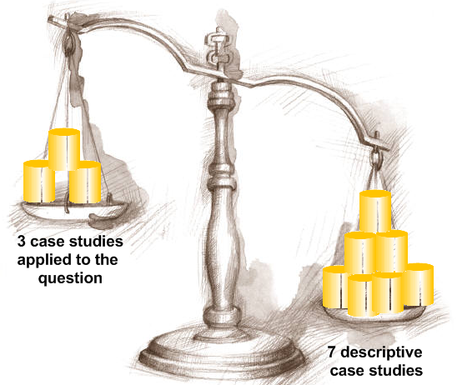
Less really is more:
The approach on the LEFT, fewer case studies are applied to the question will always score more marks that the approach on the right where endless case studies are churned out with no link to the actual question.

Slide 4
The pre-release
The ‘explore’ bullet gives you an idea of which concepts, ideas and theories you need to focus on.
The ‘research’ bullet makes suggestions about the range of case studies and examples you need.
Within the pre-release statement will be key words.
These words can also be found of you look in the specification
the pre-release statement is identifying the areas of the specification which the examination question will focus on; for instance:

Slide 5
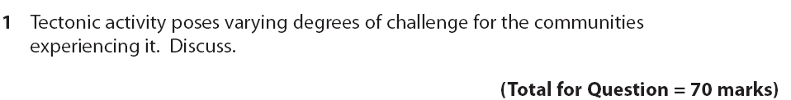
Pre-release research focus ⬇
Specification ⬇ | Section 2 Section 3
Exam Question

Slide 6
Question styles
Be prepared for a range of different questions styles and command words such as:
To what extent does successful response to tectonic hazards depend on preparation and prediction?
Tectonic hazard impacts are largely economic in the developed world and social in the developing world. Discuss
Evaluate the response to a range of tectonic hazards in contrasting physical and socio-economic locations.
All questions are very open ended and are designed to be discursive i.e. you are supposed to engage in debate and argument, look at an issue from different perspectives, and then form a judgement / conclusion.
You basically have 1 ½ hours to do this. In Jan 2010 candidates getting 70/70 were writing 8-10 sides.

Slide 7


Planning
Dividing up your time is important
danger is thinking you need to spend most of the 1 ½ hours on the ‘main bit / middle bit’ (analysis)
you need to spend quite a lot of time on the introduction and conclusion as together these account for 25 of the 70 marks (35%!).

Slide 8
Why plan?
thinking time to digest and unpick the question
consider the case studies and examples that can (and can’t) be used to support your answer
set out a structure for all parts of your answer
Writing this down will save time later and make your work logical
The examiner will look at you plan and consider it as part of your work – if you run out of time, they will look to see what you planned to put in your conclusion.

Slide 9
A simpler plan, but with some structure
The previous candidate divided their plan into sections.
It could be argued that the plan is top heavy and perhaps they could have spent more time planning the analysis and conclusion?

Slide 10
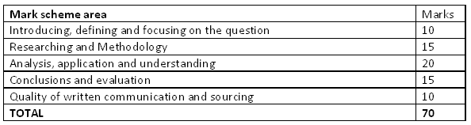
The generic mark scheme and its importance
Your report will be marked using
a generic mark scheme that applies to all Unit 4 options
a question specific mark scheme that only applies to your option

Slide 11
Product?
A structured report, not an essay
A plan
Use of sub-headings / sectioning to organise
Use of models and theories when relevant – possibly draw as diagrams
Diagrams where appropriate
Use of case studies and supporting examples
Factual detail
Correct geographical terminology
Sourcing and referencing

Slide 12
Characteristics of weaker work | Characteristics of stronger work
Unstructured essays Lack of focus on the question in the introduction Random case studies, poorly related to question focus Descriptive ‘Another case study is…” A presentation of knowledge, some of it incorrect No referencing, sourcing or hint at research methods | Well organised, sectioned reports Direct reference to question, definitions Justified case study choice Links to concepts, theories and models Explanatory, supported by factual detail / examples Links between case studies and examples drawing out overall themes A genuine discussion A genuine attempt to source, reference and mention research methods

Slide 13
Introduction
9-10 | Clear reference to title- develops a focus Indication of framework, either by concepts and/or case studies Accurate definitions of key terms
In this example the candidate:
Defines tectonic activity
Recognises that that ‘challenges’ the question asked about vary by location
Defines a ‘disaster’
Introduces the concept that a disaster is different in the developed and developing world.

Slide 14
This next candidate develops a framework by stating, briefly, where the report is headed:
We might expect to find sections, later on in the report, that relate to:
Level of economic development
Political stability
Magnitude

Slide 15
Researching & Methodology
12-15 | Wide range of relevant case studies used (by scale and or location). Relevant concepts, and/or theories used Factual, topical evidence Indication of methodology i.e. how evidence was sampled/selected
Indicate how and why you used various sources
Methodology table?
Possibly, but they are time consuming
Will tend to ‘float’ away from your report
can indicate your methods by:

Slide 16
The 2008 Sichuan earthquake in China was a devastating event. Details of it causes and impacts were researched in Geography Review (D Petley, 2009) which is a well respected, unbiased source. Prof Petley is director of the Landslides Research Centre at Durham Uni.
Selection | Brief explanations of why particular material was used e.g. one website over another
Range of research | Commenting on the range of research sources uses i.e. to provide balance and avoid bias
‘Age’ of resources | Commenting on how up to date some materials are, compared to others
Bias | Commenting on the bias that might be present in some sources e.g. the Economist compared to New Internationalist
Reliability | Commenting on the authors e.g. academic researchers versus opinions in blogs or newspaper articles
Comparison | Comparing one source to another and identifying discrepancies e.g. earthquake death tolls of economic losses
e.g.: The 2008 Sichuan earthquake in China was a devastating event. Details of it causes and impacts were researched in Geography Review (D Petley, 2009) which is a well respected, unbiased source. Prof Petley is director of the Landslides Research Centre at Durham Uni.

Slide 17
Example of a methodology paragraph

Slide 18
You won’t need to do much in the way of methodology because there are marks in this section for:
A wide range of case studies
Relevant concepts and theories
Factual, topical evidence
Good choice ☺ | Poor choice ☹
Kashmir earthquake, 2005 Samoa tsunami, 2009 Mount Pinatubo, 1991 Kobe earthquake , 1995 Haiti earthquake, 2010 | Kashmir earthquake, 2005 Bam earthquake, 2003 Sichuan earthquake, 2008 Tangshan earthquake, 1976 Great Kanto earthquake, 1923

Slide 19
Breaking your product up into a report
By case study | By concept | By concept
Introduction The tsunami China Earthquake Haiti, 2001 Conclusion | Introduction Social challenges posed by tectonic activity Economic challenges posed by tectonic activity Environmental challenges posed by tectonic activity Conclusion | Introduction Different tectonic disasters, different death tolls Tectonic location of the hazard Different wealth, different response to long-term challenges Response from authorities Conclusion
Practically, you can use subheadings:
Responses in developed countries
…or numbers
1.Responses
..or get a bit more sophisticated!
Section 2.1: Earthquake response
In Jan 2010 candidates organised their work in a number of different ways:

Slide 20
Diagrams?
Can you draw them quickly?
Are they quicker to draw than to write about the same thing?
Can you remember it, including the labels?
Have you integrated into the text?

Slide 21
Ongoing evaluation and conclusions
12-15 | Clearly stated Thorough recall of content/case studies used in essay Ongoing evaluation throughout report Understands the complexity of the question
conclusion marks include ongoing evaluation
look at this evaluative summary, followed by a comparative link:

Slide 22
This candidate has taken a much more in-your-face approach, but is works quite well
it evaluates and summarises and because this is a report the heavily structured approach is fine:

Slide 23
This candidate wrote a top level conclusion and you can learn a few tips from it:
It uses words from the question i.e. challenges
It’s broken up into small chunks, each one making a concluding point
Its language is evaluative e.g. however, furthermore.
It refers back to key evidence from the main body of the report e.g. ‘Figure 4’
It clearly states that LEDCs and MEDCs face different levels of challenge
If you were being picky, it might have been good to refer to case studies and examples used more directly.

Slide 24
QWC
9-10 | Coherent structure and sequencing with obvious report style sub sections Excellent standards of spelling and punctuation Geographical vocabulary used correctly Diagrams/maps, if used, incorporated into text and support argument Referenced/acknowledged material :obvious evidencing/sourcing from wide range of sources (texts, journals, internet, DVDs etc)

