Slide 1
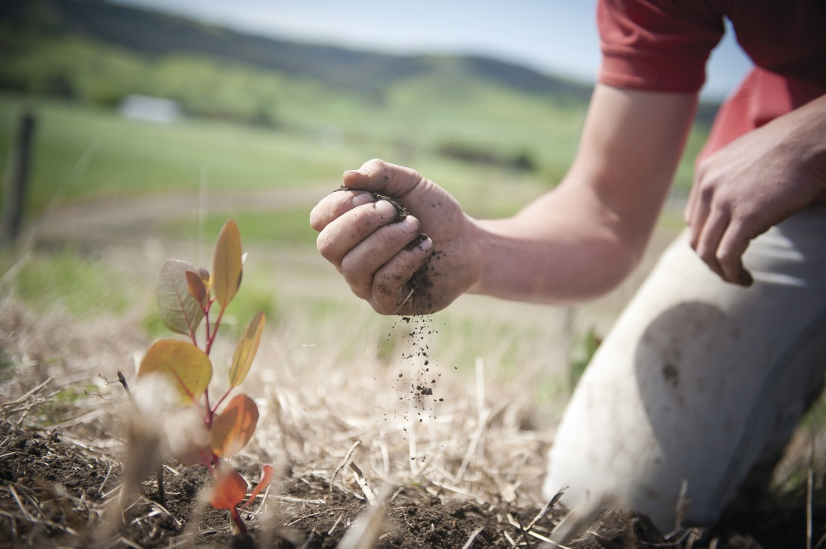
Managing Biodiversity
15th September 2014
Learning Objectives:
Who is trying to protect Daintree and why?
Learning Outcomes:
Students will know the different groups with an interest in Daintree and what they are doing to protect it
Tricky: Name some ways biodiversity can be protected.
Trickier: Why are humans interested in protecting biodiversity?
Trickiest: What factors do you think influence management of biodiversity in an area?

Slide 2
In Daintree??

Slide 3
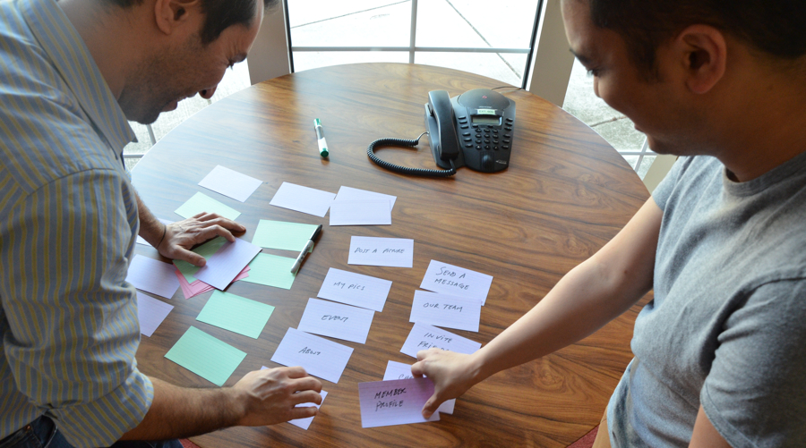
Activity: Cut out the strategies and try to add any others from pages 115 and 117. Put them in order of what strategy you think will have the greatest influence on protecting biodiversity in Daintree.
Now justify your top answer in a paragraph

Slide 4
Activity: Now stick those strategies onto your venn diagram to categorize them.

