Slide 1
Cane Toads
9th September 2014
Learning Objectives:
What are the threats to biodiversity?
What are the affects of invasive species?
Learning Outcomes:
Students will have investigated one of the major threats to biodiversity
Starter
Brainstorm as many threats to biodiversity as you can. Can you categorize these?

Slide 2
Threats to Biodiversity

Slide 3
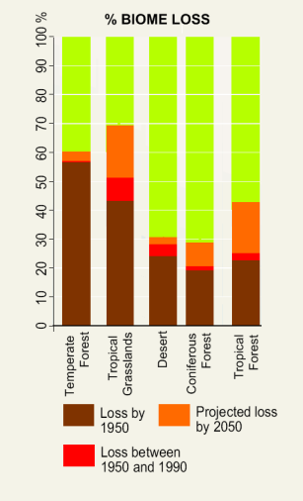
Global threats
Globally there are a number of trends which threaten ecosystems and biodiversity
Global Threat and its consequences
Global Warming | Rising sea levels threaten coastal ecosystems (coral, mangroves, estuaries) Rising ocean temperatures threaten coral through bleaching Shifts in climate zones will stress biomes; migration patterns will be altered; some biomes (tundra, montane forest) may be wiped out.
Desertification | A widespread and complex problem, some 10-20% of dryland ecosystems are already degraded; grasslands are very vulnerable Overgrazing, climate change, poor farming practice and population pressure all contribute Once soil is eroded, ecosystem recovery is very difficult
Poverty and food insecurity | Population pressure, poverty and the need to produce food are leading to unsustainable use of ecosystems worldwide Overfishing, deforestation, conversion of ecosystems into farmland are all major causes of ecosystem and biodiversity loss

Slide 4
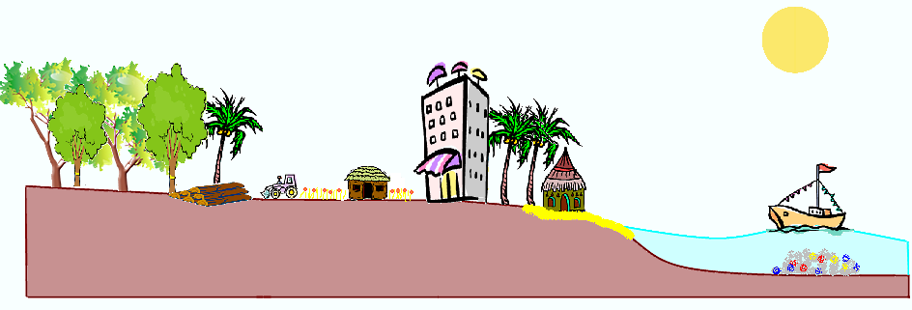
Local threats
In small scale areas, local threats can be numerous and represent a severe threat to ecosystems and biodiversity.
Localised deforestation; clearance for farming and urbanisation
Tourism development; trampling, erosion; urbanisation and associated pollution; increased risk of wildfires
Overfishing and harmful forms of fishing e.g. dynamite and cyanide
Siltation from runoff; increased risk of alien invasive species
Mining, ranching and overgrazing, road building leading to ecosystem fragmentation
Runoff from farms and urban areas; eutrophication and heavy metals in rivers, lakes and seas

Slide 5
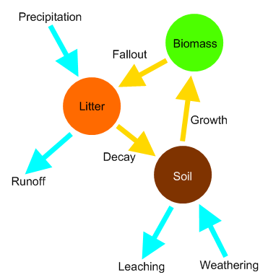
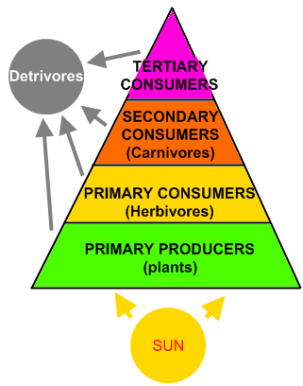
Ecosystem processes
Functioning ecosystems have a continual flow of nutrients (top) and energy (bottom) through them
These systems are self-regulating, but prone to human disruption:
Deforestation or over fishing depletes the biomass store in the nutrient cycle
Climate change may affect precipitation, runoff, decay rate and weathering rate
Alien species can disrupt the food web, changing the balance of predators and prey
Eutrophication drastically increases available nutrients

Slide 6
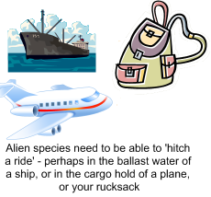
Alien invasive species
Our globalised world has increased the threat from alien invasive species
These are species which move out of their natural habitat and colonise new areas, as a result of human activity
Such species don’t move because they want to find a better place to live!
Successful invaders tend to be:
Capable of rapid reproduction
Able to disperse
Rapid growing
Tolerate a range of environmental conditions
Able to eat a wide range of foods
Species such as rats, goats, the Chinese Mitten crab and Zebra Mussel are successful, and highly destructive, aliens
Some aliens are introduced deliberately, perhaps as a food source, predator or ornamental species, but then escape into the wild and have unintended consequences
Other aliens are accidental introductions

Slide 7
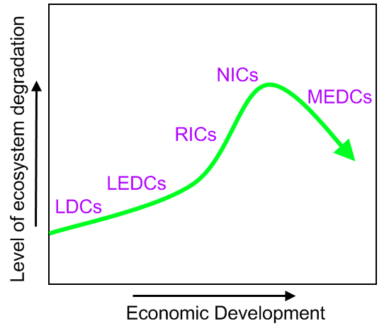
Ecosystem destruction
Pristine ecosystems are rare today
Highly developed countries tend to have few of them, although they may use their wealth to protect, conserve and restore ecosystems
Wealth, and leisure time, tend to mean people have positive attitudes to the environment
In NICs and RICs (see graph) threats to ecosystems tend to be severe, as ecosystems are used as resources and there is limited money for conservation
In less developed countries, yet to industrialise, ecosystem may not be exploited yet – but for how long?

Slide 9
Case Study: Cane Toads
Read through the cane toad case study info and highlight the key information
THEN
Write a summary paragraph on everything you have found out about cane toads this lesson
THIS IS A VERY IMPORTANT SKILL!!

