Slide 1
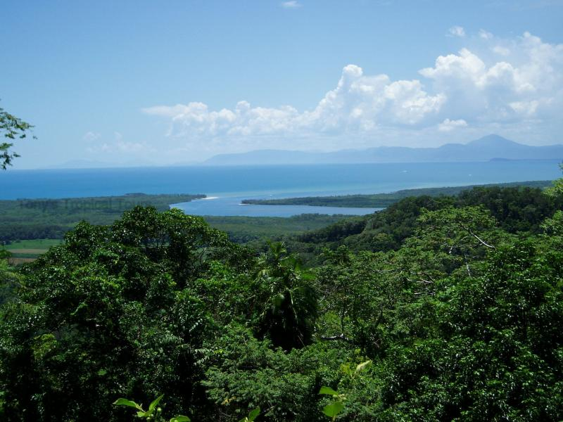
Managing Daintree
16th July 2014
Learning Objectives:
Who is trying to protect Daintree?
Learning Outcomes:
Students will know the different groups with an interest in Daintree and what they are doing to protect it
Starter 1 : Without looking back in your book, give 1 example each for Daintree of a :
Regulating ecosystem service
Provisioning ecosystem service
Cultural ecosystem service
Supporting ecosystem service
Starter 2 : Thinking about what you learnt about Daintree last lesson, what do you think the main threats to it are?

Slide 3
How VALUABLE?
WHICH OF THESE 4 IS IT EASIEST TO PUT ECONOMIC
VALUE ON?
1
WHICH OF THESE 4 IS MOST VITAL TO THE FUNCTIONING OF THE EARTH’S SYSTEMS?
2
3
4
WHICH OF THESE 4 IS VITAL TO THE WELLBEING OF THE ECOSYSTEM ITSELF?

Slide 4
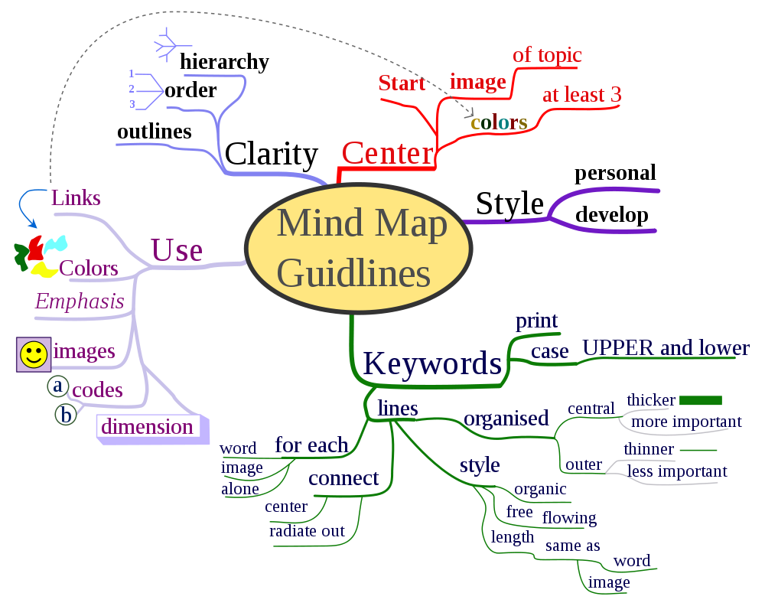
Task: Read the handout and make a mind map of the various organisations involved and information about them

Slide 5
Genetic diversity
http://www.ted.com/talks/cary_fowler_one_seed_at_a_time_protecting_the_future_of_food

Slide 6
Local management
http://www.ted.com/talks/john_kasaona_from_poachers_to_caretakers

Slide 7
Conserving the canopy
http://www.ted.com/talks/nalini_nadkani_on_conserving_the_canopy

