Slide 1
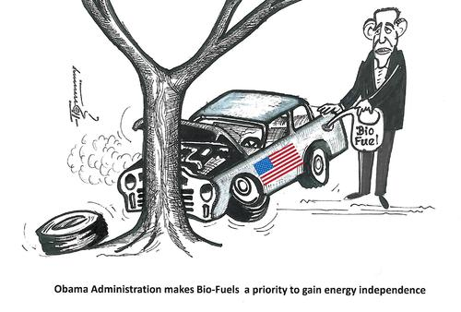
Tricky: Describe what this cartoon is showing
30th September 2014
Energy Insecurity
Trickier: What do you think is meant by ‘energy independence’ ?
Trickiest: Explain the message of this cartoon

Slide 2
ENERGY INSECURITY
Energy supply, demand and security
The impacts of energy insecurity
Energy security and the future

Slide 3
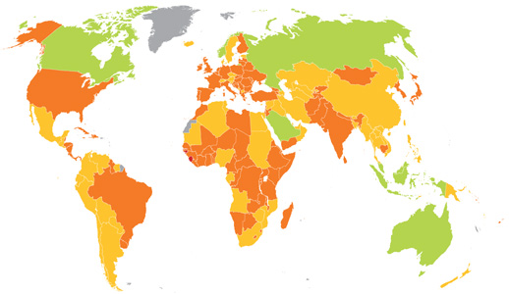

Slide 4
Definition
Write a definition for energy security in your books.

Slide 5
What does it mean to be energy secure?
To have ENERGY SECURITY means to have access to reliable and affordable energy sources e.g. Russia
Countries that do not have this and have an energy deficit are said to be ENERGY INSECURE eg USA
Key terms – learn and use

Slide 6
Types of energy
Create a spider diagram to brainstorm as many types of energy as you can.
Extra challenge: How could you categorize these?
Energy sources
e.g. oil

Slide 7
There are a wide range of energy resources, with different security of supply and environmental issues:
Non-renewable | Renewable | Recyclable
A finite stock of resources, which will run out | A flow of resources, which is infinite in human terms | Can be used repeatedly, if managed carefully
Coal, oil, gas (plus oil shale, tar sands, lignite etc.) | Wind, solar, hydroelectric, wave, tidal, geothermal | Biomass, nuclear (with reprocessing of fuel)
For each of the categories of energy resources, discuss the potential disadvantages of each

Slide 8
Achieving Energy Security
Important factors are:
Control over supplies
Control over prices
Having a variety of energy sources to call on
Political stability (in supply region as well as demand region)

Slide 9
Energy security can be threatened by:
Rapid increase in prices (oil 2004)
Instability of suppliers (Georgia 2008)
Manipulation of supply
Attack on infrastructure (terrorism)
Competition from expanding economies e.g. China
Environmental legislation which adds to the costs of finding, transporting and processing the resource

Slide 10
Energy security can be improved by:
Greater energy efficiency
Greater energy self-sufficiency
Decentralization of energy production
Short term stockpiles (90 days)

Slide 11
USA and California p 6-10 Oxford
Explain in 1-2 sides of A4 the energy problems that the USA is facing and why its energy insecurity is growing.

