Slide 1
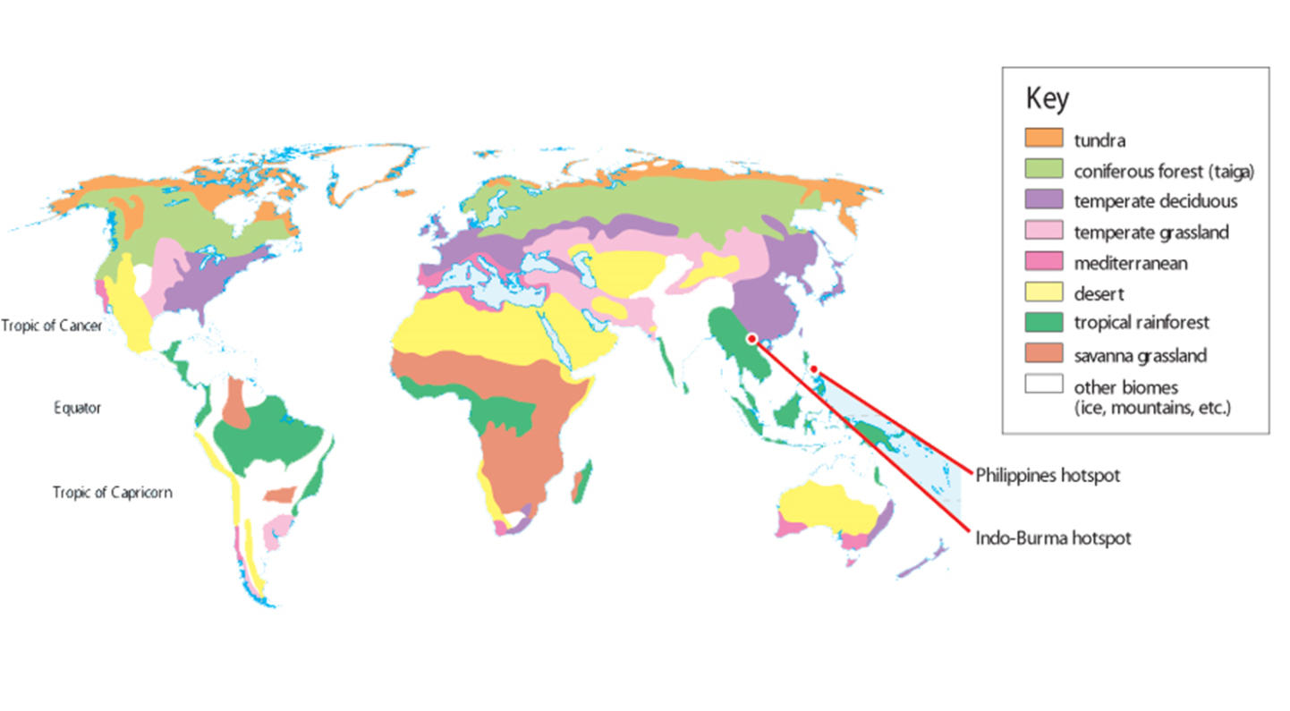
What affects biodiversity?
2nd July 2014
Learning Objectives:
What are the physical and human factors that affect biodiveristy?
Learning Outcomes:
Students will be able to answer a question on factors affecting biodiversity to their target level.
Look at the map and choose a starter.
Tricky: Describe the global distribution of different biomes
Trickier: Choose a biome and explain its distribution
Trickiest: How and why do you think biodiversity varies across these biomes?

Slide 2
Task: Using the handout, make spider diagrams to outline the key processes and factors influencing biodiversity
Climate:
Precipitation
Temperature
Light intensity
Winds
Endemism
Human activity
Key factors influencing biodiversity
Learning Outcomes:
Students will be able to answer a question on factors affecting biodiversity to their target level.

Slide 3
Reminder!
What is a Biome??
It is a naturally occurring community characterized by distinctive life forms which have adapted to the climate
e.g….
Tundra, Desert, Tropical Rainforest etc.

Slide 4
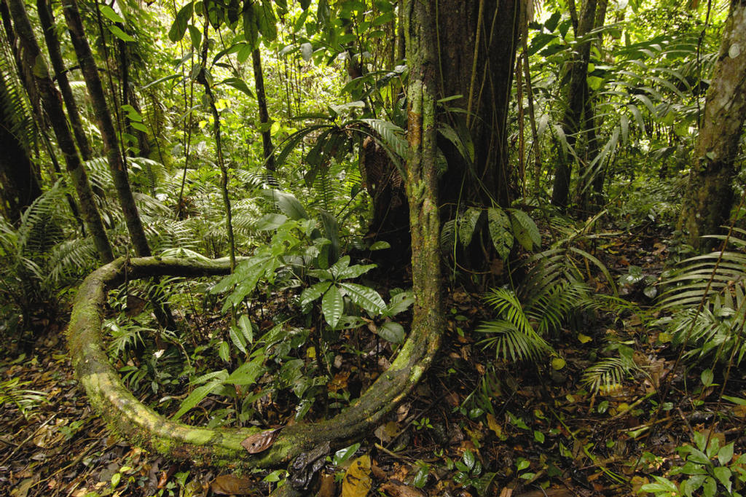
Brazil

Slide 5
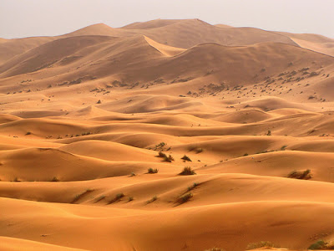
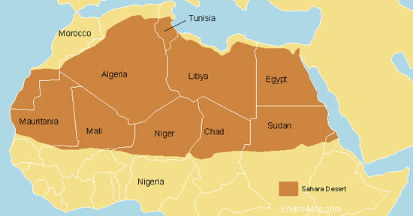
The Sahara

Slide 6
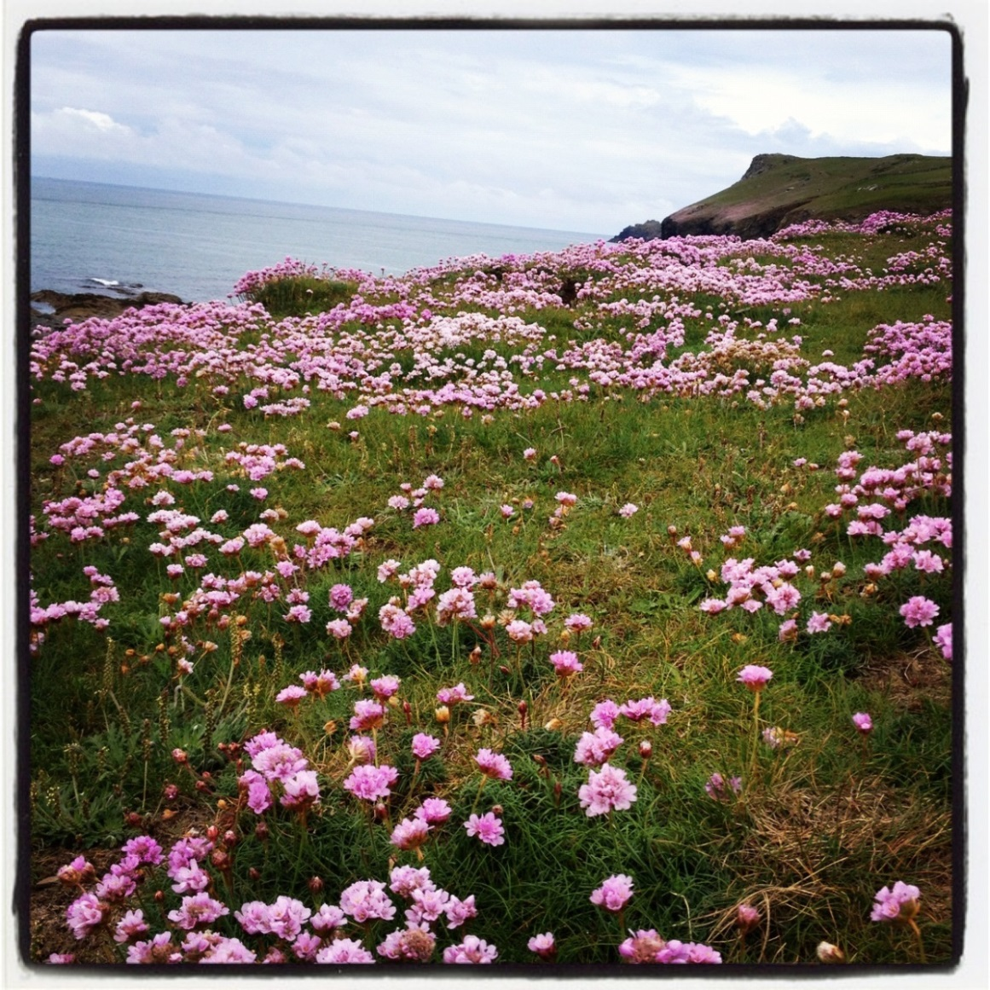
The UK

Slide 7
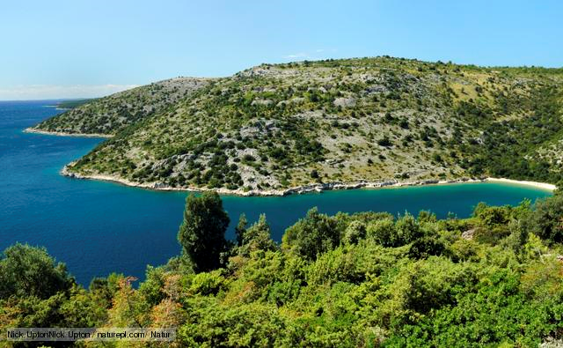
Italy

Slide 8
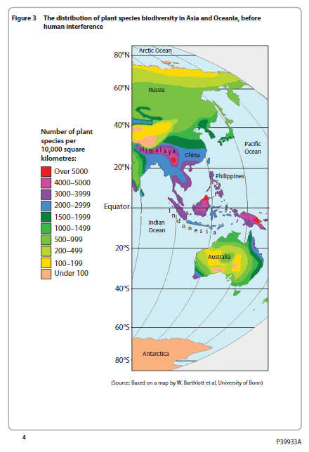
Exam Question
Explain how physical factors influence the distribution of biodiversity shown (10)

