Slide 1
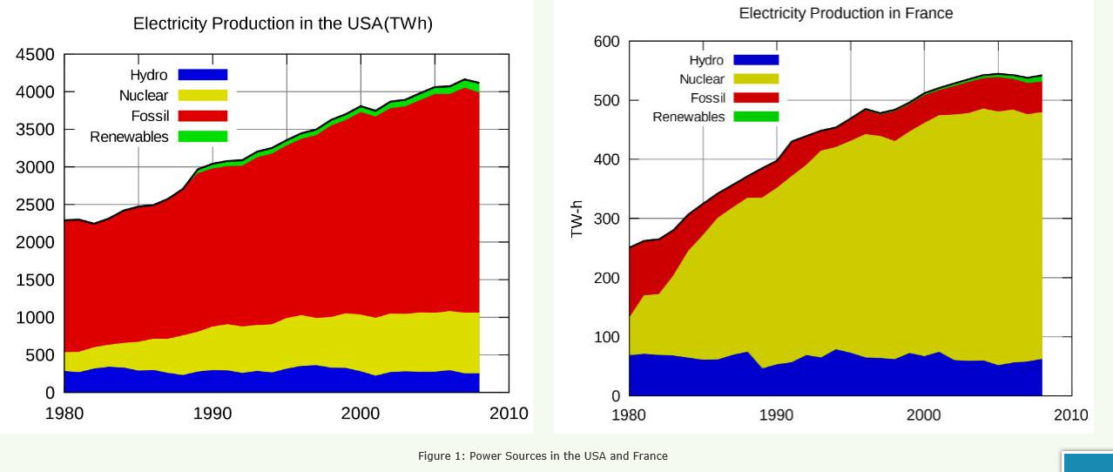
Tricky: Describe the change in energy source in both countries over the past 30 years.
C/W
7th October 2014
Energy Case Study - France
Learning Objective: How energy secure is France?
Learning Outcomes: Students will be able to use France as a case study to discuss energy security of a nation
Trickiest: Which country is more energy secure? Explain.
Trickier: Compare and contrast the energy production of the 2 countries shown

Slide 2
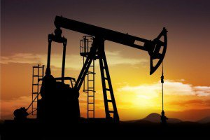
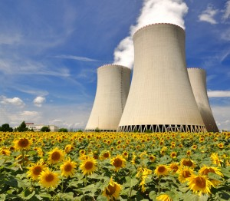
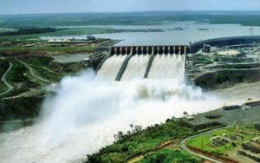
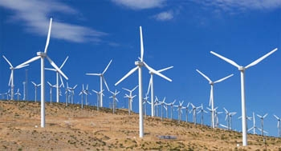
Task: In your groups, create a spider think about what factors would dictate what energy sources a country uses.
S.E.E.P.

Slide 3
Presence of natural resources
Ability to access resource
Laws/regulations
Political relations with other energy supplying nations
Physical conditions e.g. lack of wind, sun
Cultural e.g. NIMBYs
Infrastructure

Slide 4
Market Place
In your groups you need to make a poster about your section of the report. You may only use 20 words but you can use as many pictures and symbols as you wish.
Nominate an expert to stay and man the marketplace

