Slide 1
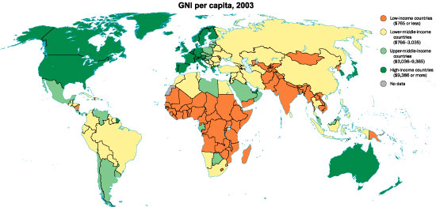
Bridging the Development Gap 27th Jan 2015
Learning objective: What is the development gap and how can we measure it?
Learning outcome: Students will be able to explain the development gap and the different ways of measuring it
Starter: Using these images and the data table you have been given, attempt to redraw the Brandt line on your map to reflect current development levels

Slide 2
What measures were most important when you were deciding where to draw the line?

Slide 3
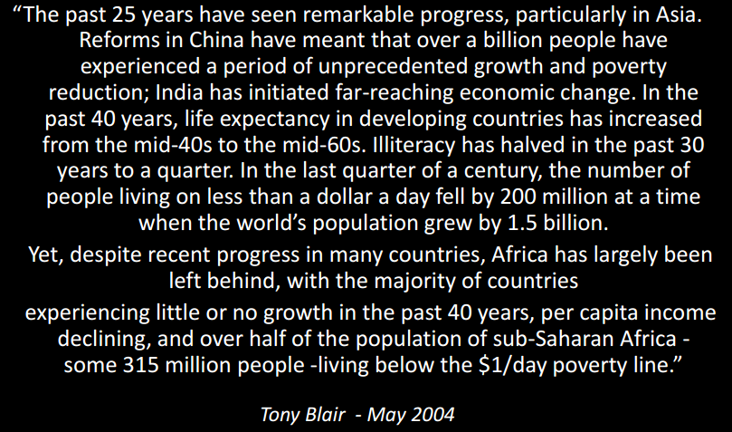
Think-pair-share: What does the term development mean?

Slide 4
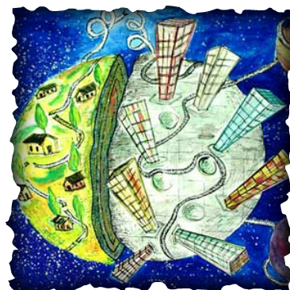
Development: The use of resources to improve the quality of life in a country.
Often linked with change for the better, but is this too much of a Euro-centric view?

Slide 5
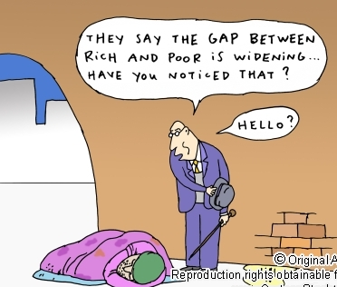

Slide 6
Measuring the development gap
Development generally means the ways in which
a country seeks to develop economically and to
improve the standard of living for its inhabitants.
The development gap describes the widening
difference in level of development between the
worlds richest and poorest countries. It can also
occur within countries, for e.g. between regions
or between urban and rural areas.

Slide 7
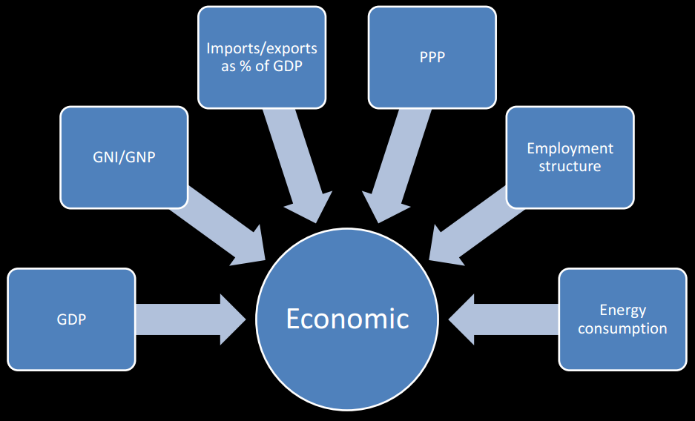
Economic Measures of development and welfare

Slide 8
GDP – Gross Domestic Product

Slide 9
Purchasing Power Parity - PPP

Slide 10
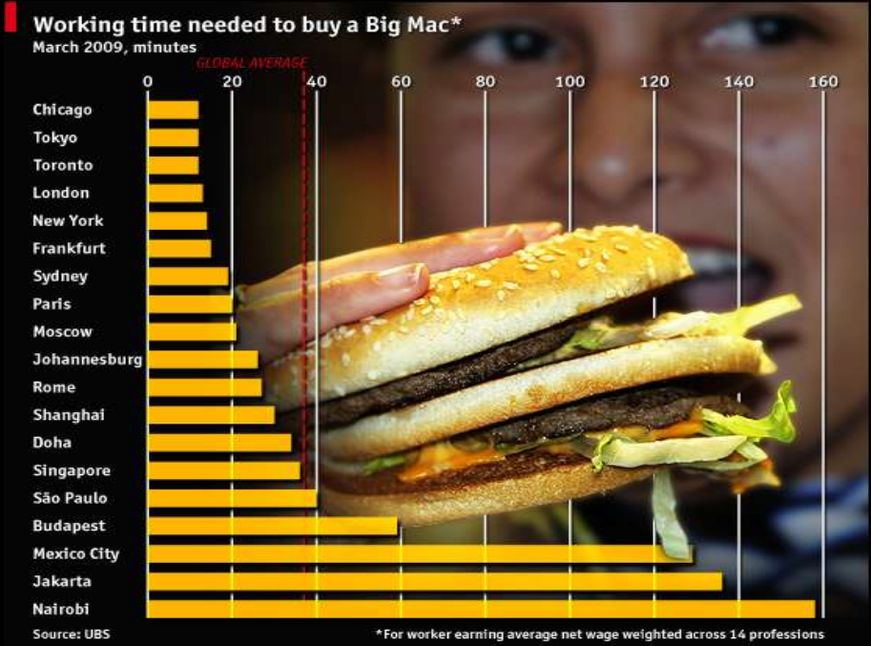
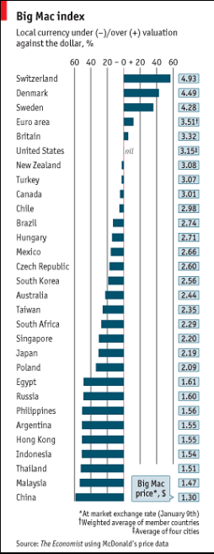

Slide 11
Gross National Income - GNI

Slide 14
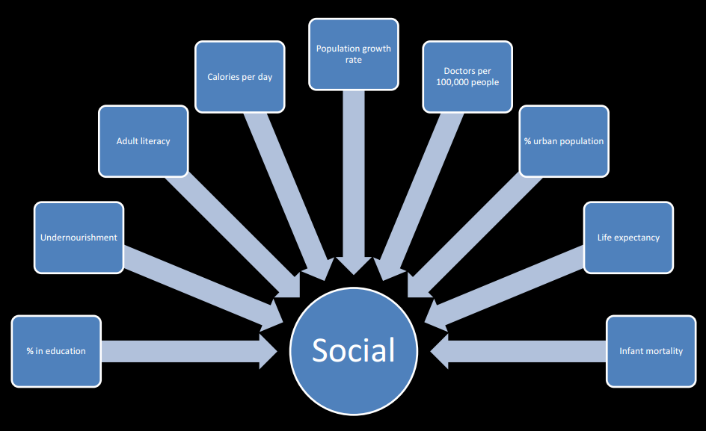
Social Measures of development and welfare

Slide 15
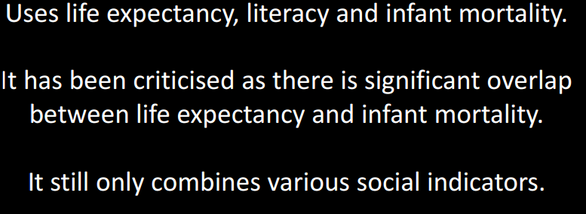
Physical Quality of Life Index - PQLI

Slide 16
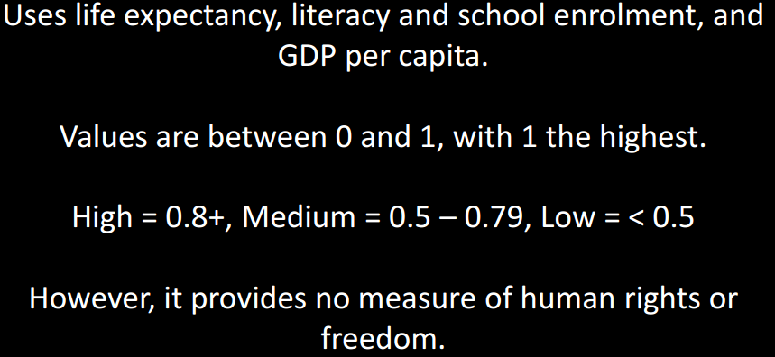
Human Development Index - HDI
The Human Development Index (HDI)
Life expectancy at birth + Literacy rate + Enrolment rate + GDP per capita PPP

Slide 18
Data Collection

Slide 19
Development Indicator (with brief description) | Strengths | Limitations
Use the Geofile and your textbooks to fill in the table for 3 development indicators. HDI must be one of them

Slide 21
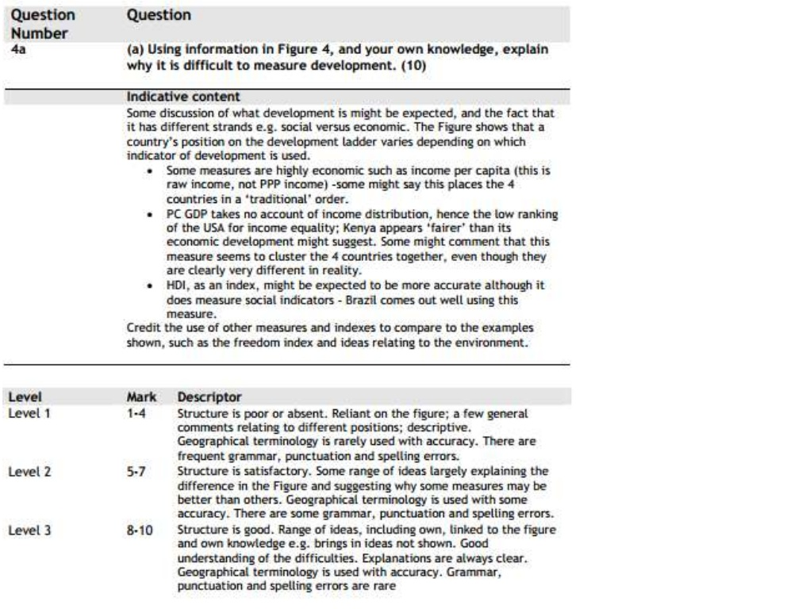

Slide 22
The development gap
The geography of the development gap is more complex than a simple ‘North-South divide’
Latin America has HDI levels similar to eastern Europe; China’s HDI and some others in SE Asia are relatively high
South Asia has a concentration of levels below 0.6
Level in the Middle East are relatively high, although not in Yemen, Syria and Iraq
The picture for Africa is very complex, with the extreme north and south having decent HDI levels, but some regions with shockingly low numbers

Slide 23
Review Question
Identify the advantages and disadvantages of
three different ways of measuring the
development gap.

