Slide 1
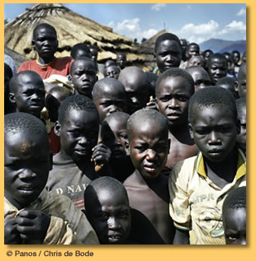
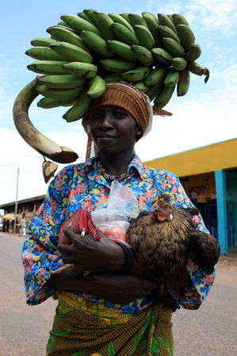
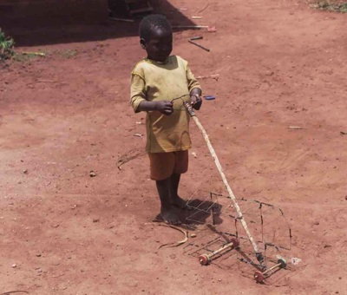
The development gap in Uganda
C/W
29th January 2015
L.O. Why is Uganda suffering from poverty?
Tricky: What factors do you think have led to Uganda not developing as much as other countries around the world?
Trickier: Do tricky and try to categorise these factors into S.E.E.P.

Slide 2
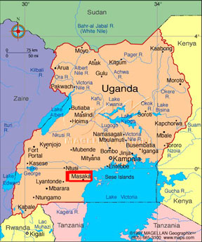
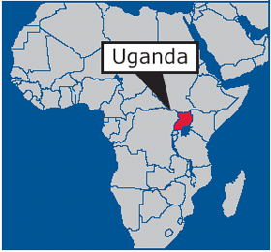

Slide 6
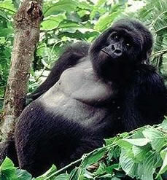
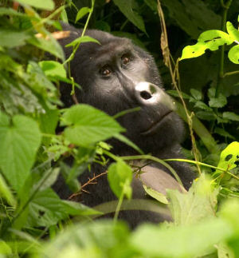

Slide 7
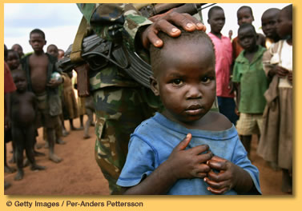

Slide 8
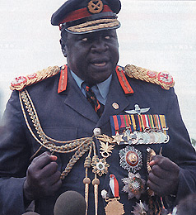

Slide 9
Task: Complete the table of indicators to compare the UKs level of development to that of the Uganda. Use pages 184-185.
Indicator | UK | Uganda
Population
Area | 244,820 km sq | 236,040 km sq
Resources
GDP (PPP)
Life expectancy
Access to safe water
Infant Mortality rates
Secondary education (girls)
HDI

Slide 10
Indicator | UK | Uganda
Population | 61 million | 31 million
Area | 244,820 km sq | 236,040 km sq
Resources | Coal, gas, oil | Copper, cobalt, H.E.P, fertile volcanic soil
GDP (PPP) | $33238 | $1454
Life expectancy | 79 | 49.7
Access to safe water | 100% | 60%
Infant Mortality rates | 5 per 1000 live births | 20 per 1000 live births
Secondary education (girls) | 100% | 17%
HDI | 0.946 | 0.505

Slide 11
Reasons for poverty in Uganda:
Economic: Economy
Debt
Political: Government
Social: Health
Education

Slide 12
1) Economy –
What is the Ugandan economy based on? (pg 184)
(why is this a problem?)
2) Debt –
How did Uganda end up in so much debt? (pg 186)
3) Government –
What is the history of government in Uganda? (pg 186)
4) Health –
What is the quality of health in Uganda? (pg 184)
How does this effect Ugandan development?
5) Education –
What is the level of education like in Uganda? (pg 185)
How does this effect Ugandan development?

Slide 13
Plenary:
Rank the five main reasons in order from 1 to 5
1 being the main reason for Ugandan poverty,
5 being the least important reason
1
2
3
4
5
Justify your ranking

Slide 14
Using examples, explain the causes of the development gap (15)
Peer mark essay using template sheet
Using Uganda as an example - Causes:
Environmental factors – diseases and climate issues
Government history (colonialism and Idi Amin)
Type of economy based on primary products and exports *
Health care factors including HIV/AIDS *
Educational standards *
Debt and SAPs *
* Denotes self reinforcing cycle

Slide 15
Using examples, explain the causes of the development gap (15)
Peer mark essay using template sheet
Level | Descriptor
4 13-15 9-10 A | Well- Balanced Carefully structured. Genuine assessment with supporting evidence; cogent discussion of the issue. Explanations are always clear. Geographical terminology is used with accuracy. Grammar, punctuation and spelling errors are very rare.
3 9-12 7-8 B-C | Balanced. Structure is good. Varied ideas and examples provided. Sound understanding of the issue; some terminology present in an account which uses some examples effectively; implied assessment. Descriptive language is precise. Explanations are always clear. Geographical terminology is used with accuracy. Grammar, punctuation and spelling errors are rare.
2 6-8 5-6 D-E | Poorly balanced. Structure is satisfactory.; likely to agree with the statement and provide some evidence to support it, but limited depth Descriptive language generally accurate. Explanations are clear, but there are areas of less clarity. Geographical terminology is used with some accuracy. There are some grammar, punctuation and spelling errors.
1 1-5 1-4 U | Un-balanced. Structure is poor or absent. A few ideas only; a basic understanding of the question and a few examples mentioned briefly. Generalised. Descriptive language is basic. Explanations are over simplified and lack clarity. Geographical terminology is rarely used with accuracy. There are frequent grammar, punctuation and spelling errors.

