Slide 1
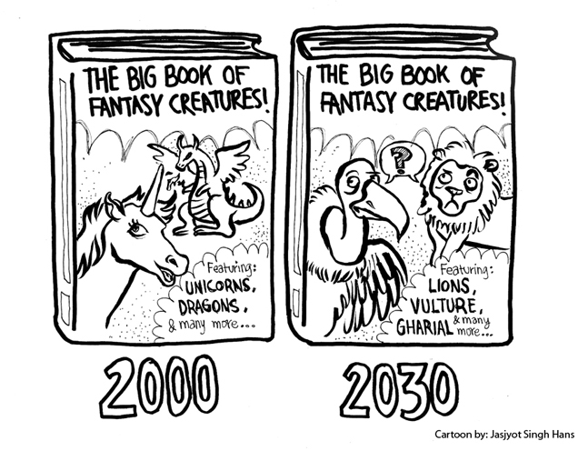
What is biodiversity?
2nd July 2014
Learning Objectives:
What is the structure of the course and this unit?
What is biodiversity?
What are the measures of biodiversity and when is each appropriate?
Learning Outcomes:
All - Students will be able to define each of the biodiversity measures.
Most - Students will be able to apply the correct biodiversity measure to a variety of scenarios.
Some – Students will be able to justify which biodiversity measure is most appropriate to a variety of scenarios.
Look at the cartoon and choose a starter.
Tricky: What message is this cartoon trying to convey?
Trickier: Suggest reasons why the book cover looks so different 30 years on.
Trickiest: What do you think is the biggest factor that has influenced the change shown? Justify your answer

Slide 2
Unit 3: Contested Planet
Energy security
Superpowers geography
Water conflicts
Bridging the development gap
Biodiversity under threat
The technological fix?
Outcomes:
All - define each of the biodiversity measures.
Most - apply correct biodiversity measure to variety of scenarios.
Some –justify which biodiversity measure is most appropriate.

Slide 3
Biodiversity definition
Task: Create a definition for biodiversity in under 20 words.
‘the variety of plant and animal life in the world or in a particular habitat’
Homework: Complete your yellow glossary
Outcomes:
All - define each of the biodiversity measures.
Most - apply correct biodiversity measure to variety of scenarios.
Some –justify which biodiversity measure is most appropriate.

Slide 4
Biodiversity under threat
Biodiversity is a key resource, which provides a range of valuable goods and critical services to human populations. Biodiversity results from natural physical processes, and as such has distinct geographical patterns. Locally, where biological resources are valued short-term for their immediate economic potential, biodiversity is often under threat through over-exploitation.
However, global threats such as climate change and the role of alien species are also important.
This topic has three overarching enquiry questions. What do you think they could be?
Outcomes:
All - define each of the biodiversity measures.
Most - apply correct biodiversity measure to variety of scenarios.
Some –justify which biodiversity measure is most appropriate.

Slide 5
Enquiry Questions for ‘Biodiversity under threat’
What is the nature and value of biodiversity?
What factors and process threaten biodiversity?
Can the threats to biodiversity be successfully managed?
Outcomes:
All - define each of the biodiversity measures.
Most - apply correct biodiversity measure to variety of scenarios.
Some –justify which biodiversity measure is most appropriate.

Slide 6
What will we be learning?
Task: Match the content to the enquiry question!
Outcomes:
All - define each of the biodiversity measures.
Most - apply correct biodiversity measure to variety of scenarios.
Some –justify which biodiversity measure is most appropriate.

Slide 7
What are the types of biodiversity?
Task:
In groups of 3. Each person will be given information on one of the types of biodiversity. You need to fill in the sheet for the type you have been given.
Make sure you have good notes because you will be teaching others.
Outcomes:
All - define each of the biodiversity measures.
Most - apply correct biodiversity measure to variety of scenarios.
Some –justify which biodiversity measure is most appropriate.

Slide 8
3 types of biodiversity
Biodiversity
Genetic Diversity. The genetic variability within one species.
Species Diversity. The number of different species within an area.
Ecosystem Diversity. The range of different ecosystems, habitats and niches in an area.
Outcomes:
All - define each of the biodiversity measures.
Most - apply correct biodiversity measure to variety of scenarios.
Some –justify which biodiversity measure is most appropriate.

Slide 9
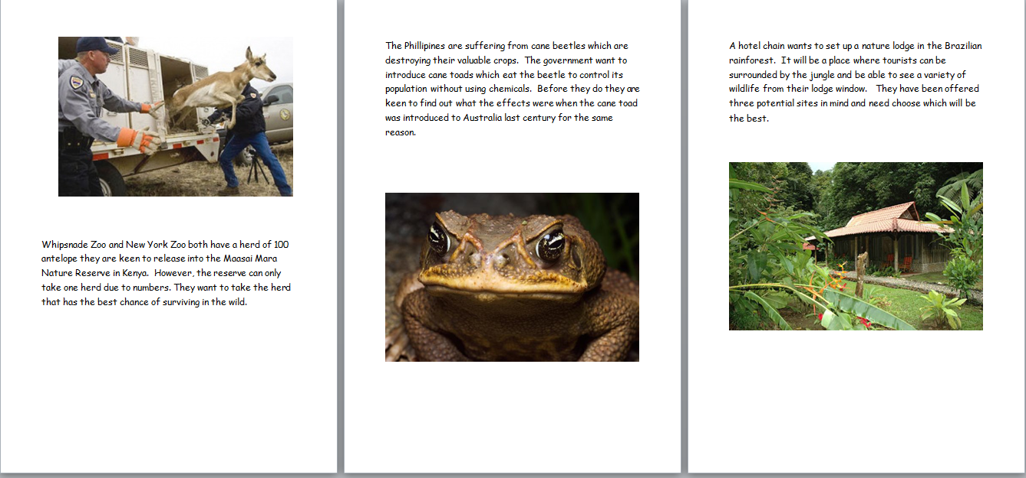
Use your knowledge
There are 3 scenarios for you to look at. For each one:
Say which measure of biodiversity would be most appropriate.
Justify why that method is better than the other 2.
Outcomes:
All - define each of the biodiversity measures.
Most - apply correct biodiversity measure to variety of scenarios.
Some –justify which biodiversity measure is most appropriate.

Slide 10
What have you learnt?
Complete your exit ticket and hand back in.
Think about what you knew at the beginning of the lesson and what you know now.
Outcomes:
All - define each of the biodiversity measures.
Most - apply correct biodiversity measure to variety of scenarios.
Some –justify which biodiversity measure is most appropriate.

